Slide 1


20CSD302 Mini Project
Final External Review
LEARN . GROW . EXCEL

Slide 2
Project Topic: OrderByte
Presented By
Merlyn Mary Stephen - 23
Rinny Anna Thomas - 41
Shalin Ann Thomas - 53
Sneha Mariam Samuel - 61
Supervisor
Name: Er.Thomas Joseph
Designation: Assistant Professor
LEARN . GROW . EXCEL

Slide 3
Contents
1. Introduction
2. Project Plan
3. Scope of the Mini Project
4. Requirements Analysis
5. Design Diagrams
i. Use case diagram
ii. Class diagram
iii. Sequence diagram
iv. Workflow diagram
6. System Architecture
7. Technology Stack
8. Conclusion
9. References
10. Appendix
LEARN . GROW . EXCEL

Slide 4

Introduction
OrderByte, is a web-based platform designed to:
Allow end users to preorder meals and make payments online, ensuring their selected meals are reserved and ready for collection.
Enhance the food service experience by eliminating the need to wait in long queues, making the process more efficient and convenient.
LEARN . GROW . EXCEL

Slide 5
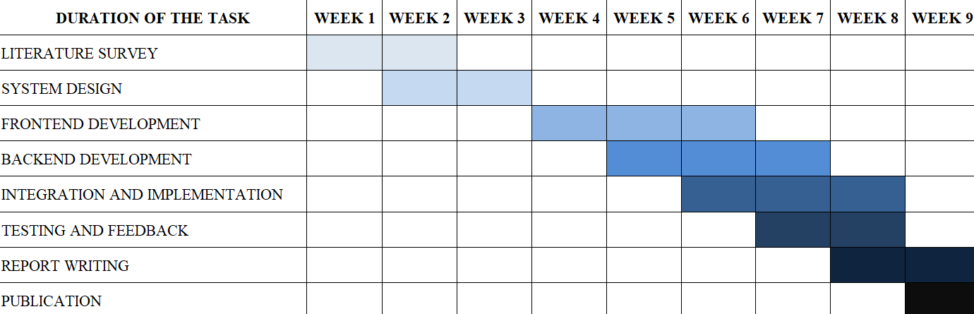
Project Plan
LEARN . GROW . EXCEL

Slide 6
Scope of the Mini Project
Users: Students, Staff, Parents, Visitors, and Canteen Admins.
Phased implementation: Development, deployment, and future enhancements.
Core Functionalities
Preordering: Advance meal booking to reduce waiting times.
Demo Payment System: Uses a mock card payment system.
Order Management: Displays orders but lacks real-time updates and reporting.
User Profiles: Personalized order history and profile management.
Technology Scope
Web-based platform with a backend database.
Web-based platform running on localhost on a laptop
Accessibility
Available on web browsers for desktop.
LEARN . GROW . EXCEL

Slide 7
Requirements Analysis
Feasibility Study
Traditional canteens face issues like long queues, food waste, and slow order processing. OrderByte streamlines food ordering through digital automation, leveraging Firebase for real-time updates and Flask for backend efficiency. It reduces wait times, optimizes resources, and enhances affordability while maintaining service quality. With analytics tools, admins can monitor trends and refine inventory. The scalable architecture ensures adaptability to future needs.
Non-functional requirements
Scalability – The system should handle an increasing number of users and orders without performance degradation. Performance – Orders should be processed in real-time with minimal latency, ensuring smooth user experience. Security – User authentication, role-based access control, and secure data transmission (e.g., HTTPS, Firebase authentication) should be implemented.
LEARN . GROW . EXCEL

Slide 8
Requirements Analysis
Usability – The interface should be intuitive, easy to navigate, and responsive across different devices (mobile, tablet, desktop). Reliability & Availability – The system should maintain high uptime and recover from failures quickly, ensuring uninterrupted service. Maintainability – Code should be modular and well-documented to facilitate updates, bug fixes, and feature enhancements. Compatibility – The web application should be accessible across major browsers (Chrome, Firefox, Edge) and work well with different screen sizes. Data Integrity – The system should prevent duplicate entries, incorrect order processing, and unauthorized modifications of order records.
Compliance – The platform should adhere to data privacy regulations, ensuring that user data is securely stored and managed.
LEARN . GROW . EXCEL

Slide 9
Requirements Analysis
Software Requirements
Python & Flask Backend development with clean syntax and extensive libraries Flask ensures rapid development and seamless integration with Firebase.
Firebase Database Real-time synchronization, secure authentication, and scalable NoSQL storage Serverless architecture simplifies backend operations.
HTML ( Hyper Text Markup Language) structures web pages with headings, links, and images Works with CSS & JavaScript for responsive designs.
CSS (Cascading Style Sheets) defines visual presentation (colors, fonts, layout) ensures a consistent and responsive design.
JavaScript adds interactivity, animations, and real-time updates Enhances user engagement and supports advanced frameworks.
RazorPay is used to simulate secure and seamless online payment.
LEARN . GROW . EXCEL

Slide 10
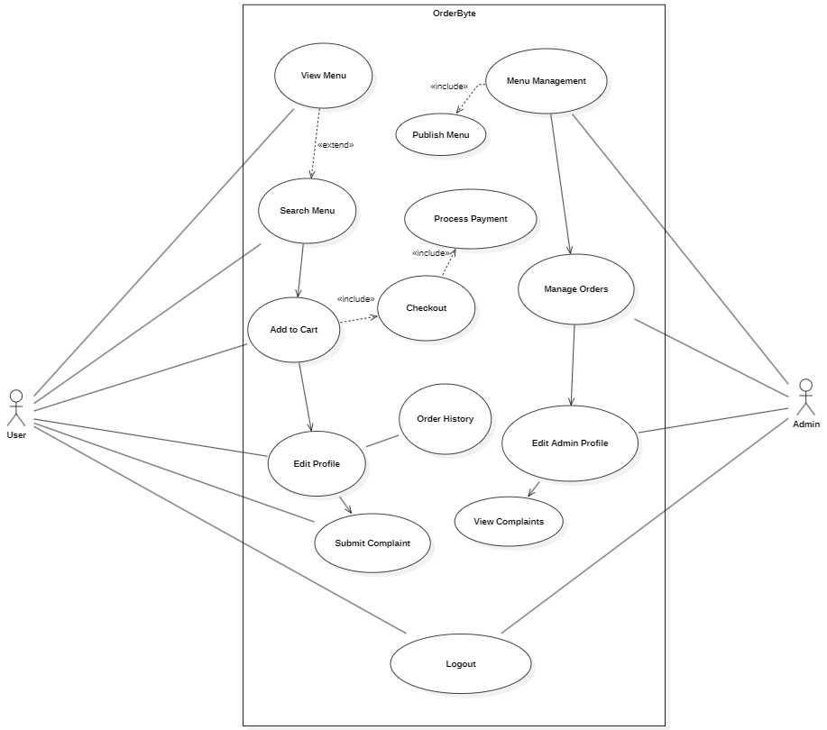
Use Case Diagram

Slide 11
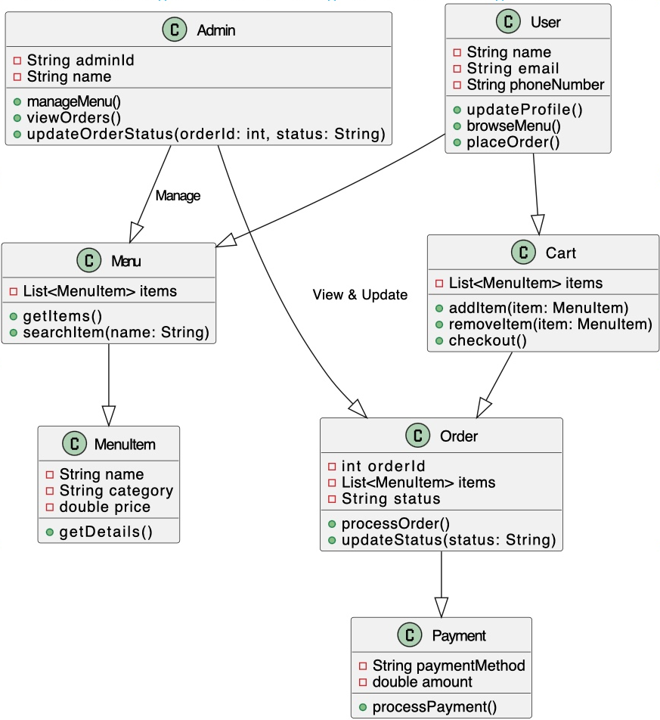
Class Diagram

Slide 12
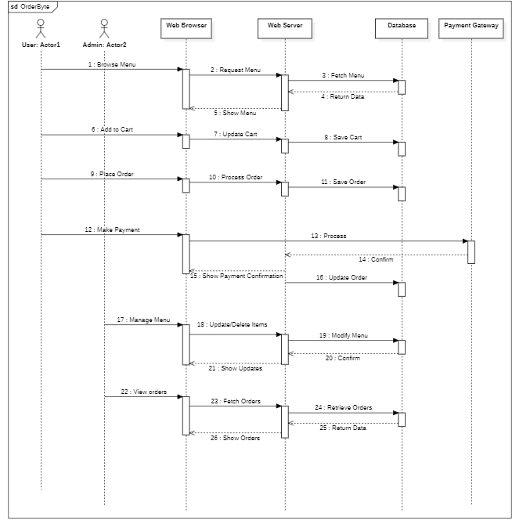
Sequence Diagram

Slide 13
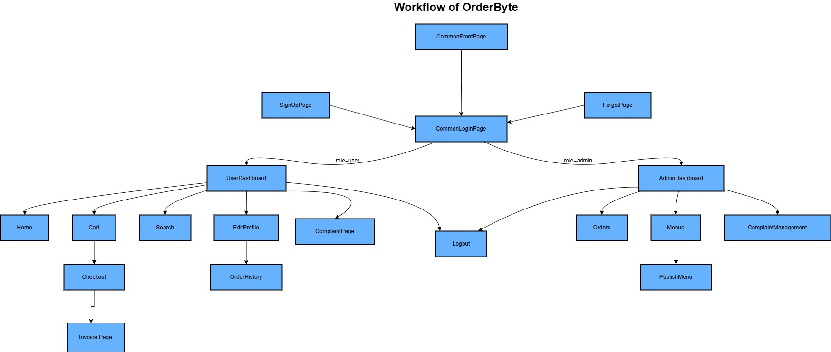
Workflow Diagram

Slide 14
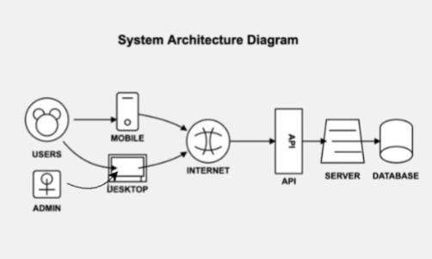
System Architecture Diagram

Slide 15
System Architecture Diagram
The OrderByte system architecture consists of:
User/Admin: Accesses the system via a web browser on desktop or mobile.
Internet: Connects the frontend to the backend services.
API: Handles communication between the frontend and backend.
Web Server: Hosts the frontend and processes requests.
Backend Services: Includes Menu Management for updating available items, Order Processing for handling user orders, User Service for authentication and profiles, and Demo Payment Handling for transactions.
Database (Firebase Realtime DB): Stores menu items, orders, user data, and demo transaction records.
LEARN . GROW . EXCEL

Slide 16

Technology Stack
HTML
CSS
JavaScript
Firebase
Python Flask

Slide 17
Conclusion
Preorder Booking: Allows users to book meals in advance, reducing wait times.
Minimizing Food Crowding: Efficient meal scheduling prevents overcrowding.
Enhancing Canteen Operations: Streamlined processes improve service efficiency.
Punctual & Well-Organized System: Ensures timely meal preparation and delivery.
Customer-Friendly Experience: Reduces hassle and enhances user satisfaction.
Secure Online Payments: Enables fast, safe, and seamless transactions with multiple payment options.
LEARN . GROW . EXCEL

Slide 18
References
[1] Lalitha, V., et al. "E-Canteen Management System based on Web Application." 2022 International Conference on Communication, Computing and Internet of Things (IC3IoT). IEEE, 2022.
[2] Xu, Zixuan, et al. "The design of nutrition ordering system without queuing in the college canteen." 2020 International Conference on Computer Information and Big Data Applications (CIBDA). IEEE, 2020.
[3] Ardiansyah, Muhammad Rizqi, et al. "The Website-Based Food Booking System Equipped with Real-Time Booking Status to Address Queuing Issues at Restaurants." 2021 International Conference on Electrical and Information Technology (IEIT). IEEE, 2021.
[4] Avhad, Prashant, et al. "Canteen automation system with payment gateway." Proceedings of the 3rd International Conference on Advances in Science & Technology (ICAST). 2020.
[5] Gosalia, Jay, et al. "MERN-Based Canteen Management System: IoT Integration for RFID Payment and Table Reservation." Available at SSRN 4802301 (2024).
LEARN . GROW . EXCEL

Slide 19
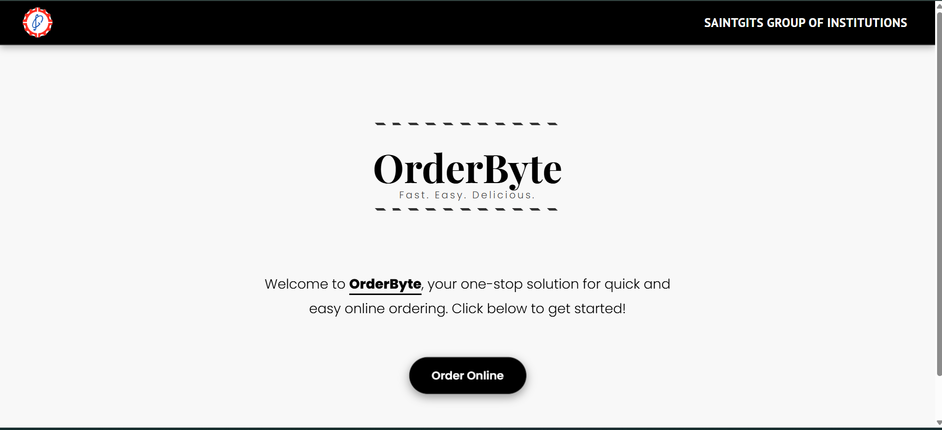
Index Page
LEARN . GROW . EXCEL

Slide 20
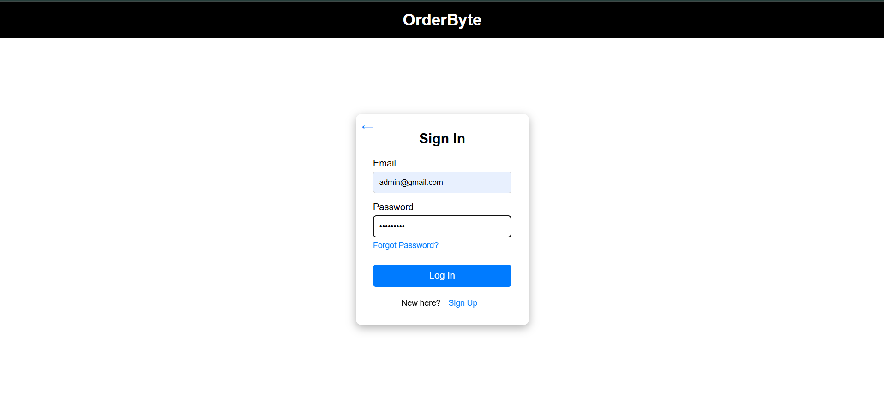
Sign-In Page
LEARN . GROW . EXCEL

Slide 21
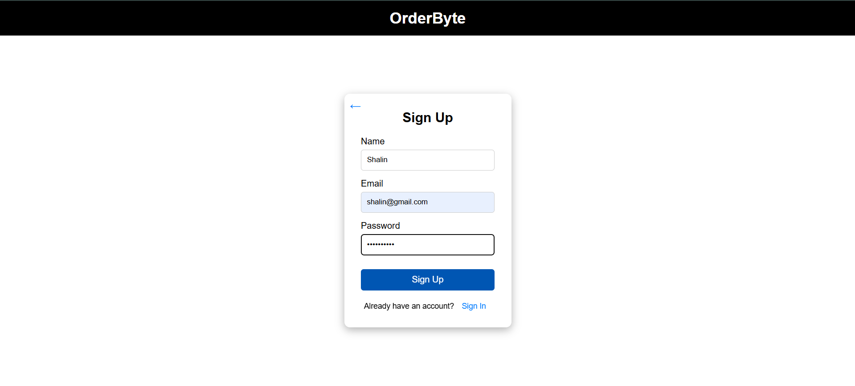
Sign-Up Page
LEARN . GROW . EXCEL

Slide 22
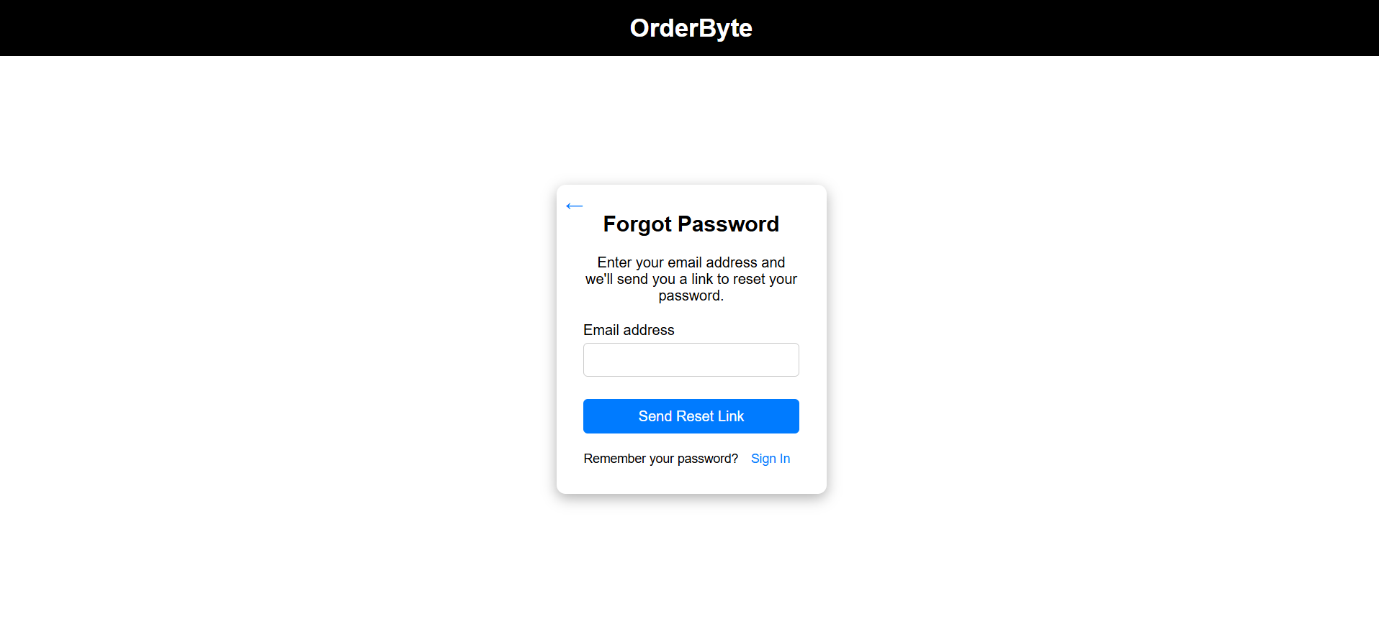
Forgot Password Page
LEARN . GROW . EXCEL

Slide 23
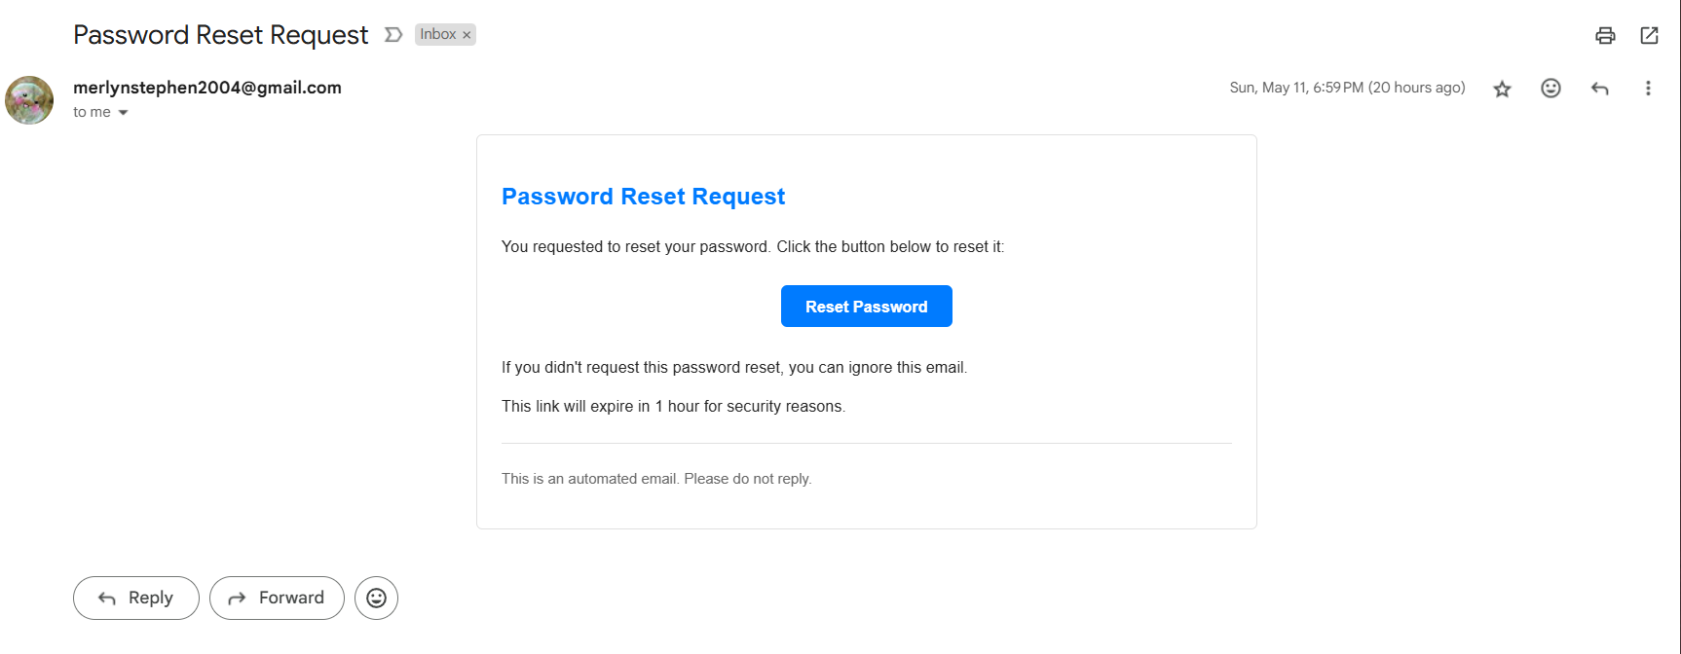
Reset Password Email
LEARN . GROW . EXCEL

Slide 24
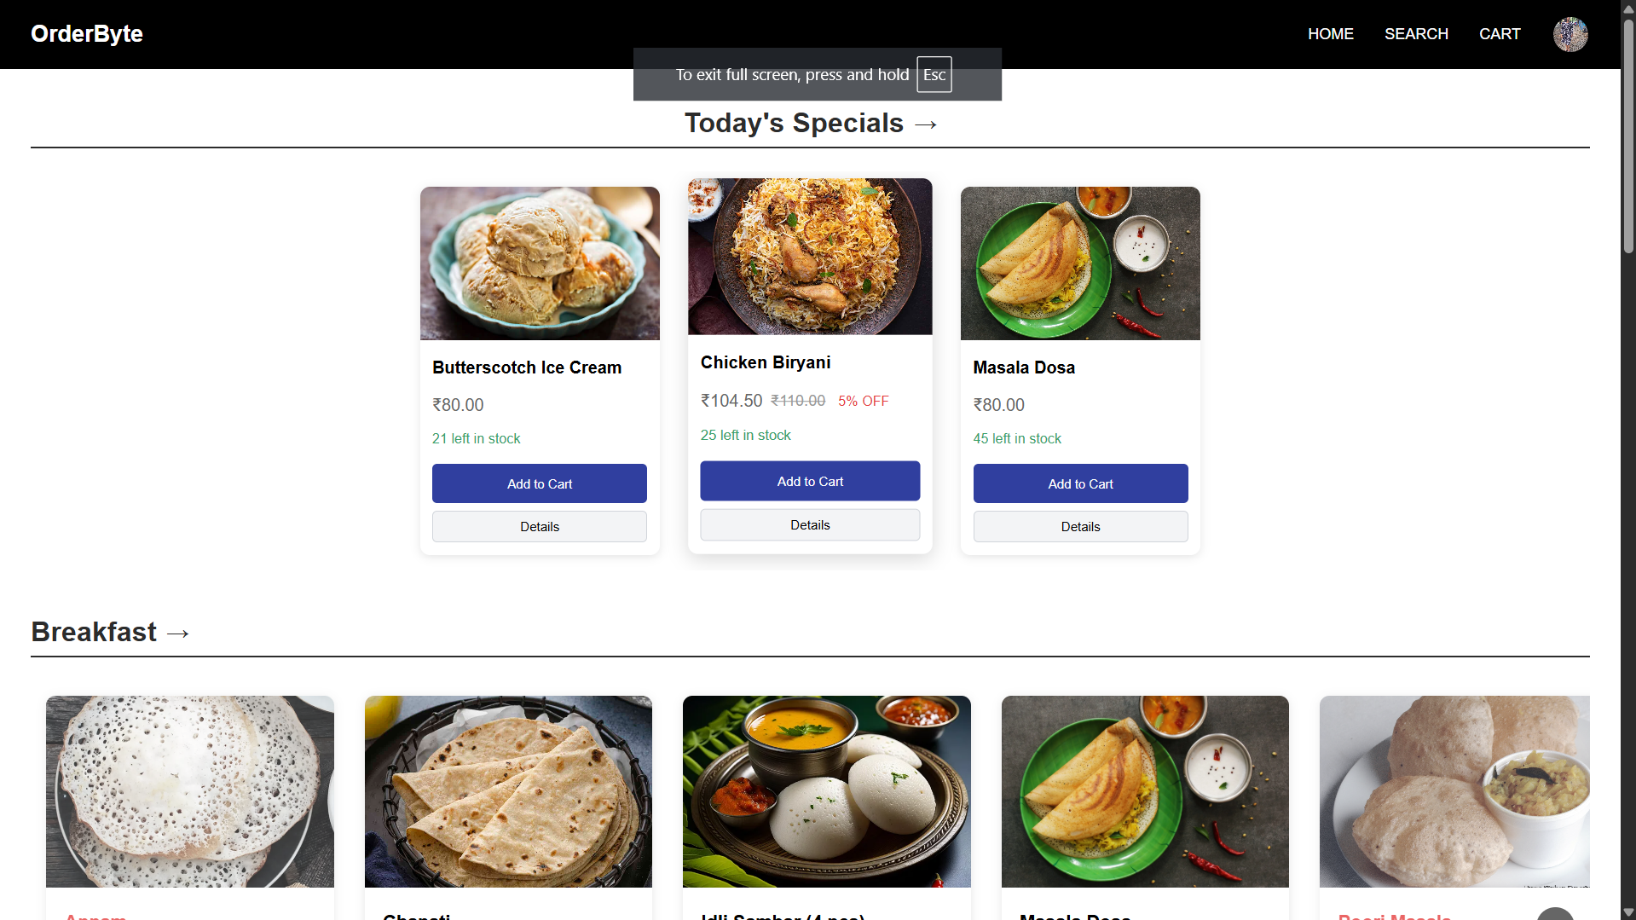
User Home Page
LEARN . GROW . EXCEL

Slide 25
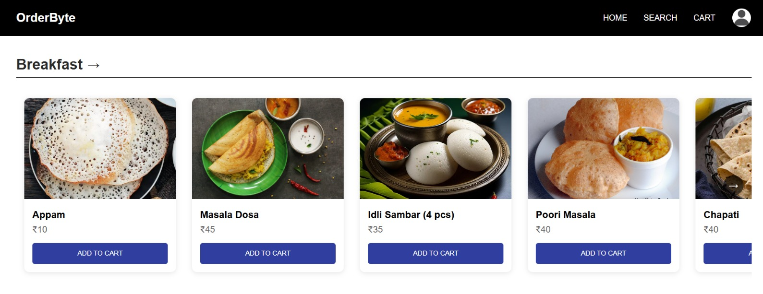
User Home Page
LEARN . GROW . EXCEL

Slide 26
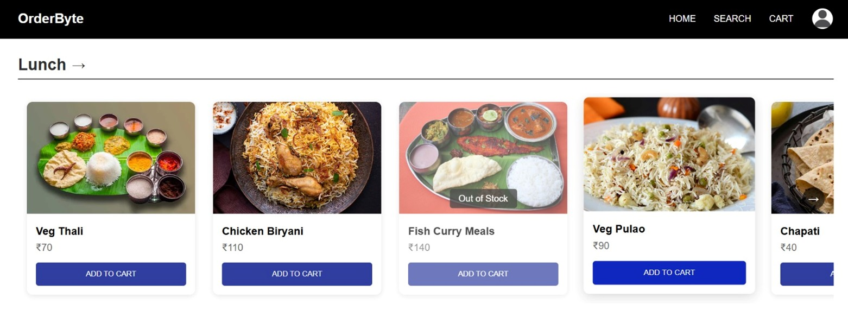
User Home Page
LEARN . GROW . EXCEL

Slide 27
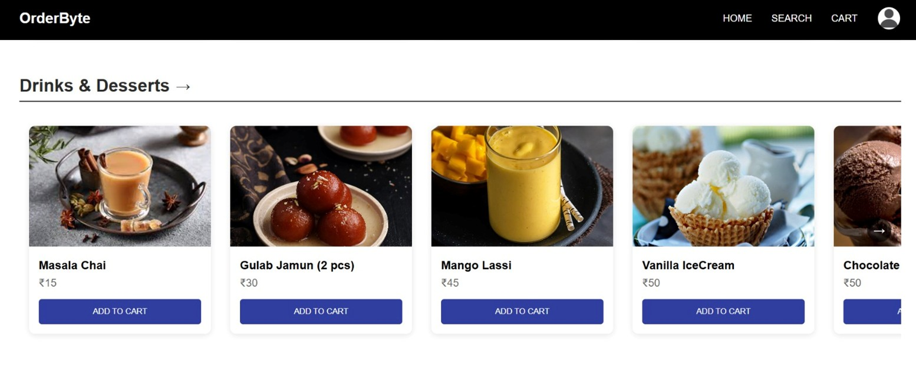
User Home Page
LEARN . GROW . EXCEL

Slide 28
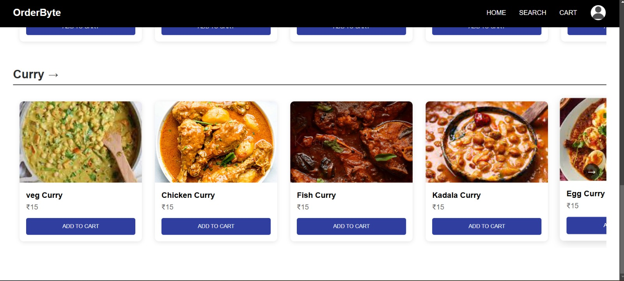
User Home Page
LEARN . GROW . EXCEL

Slide 29
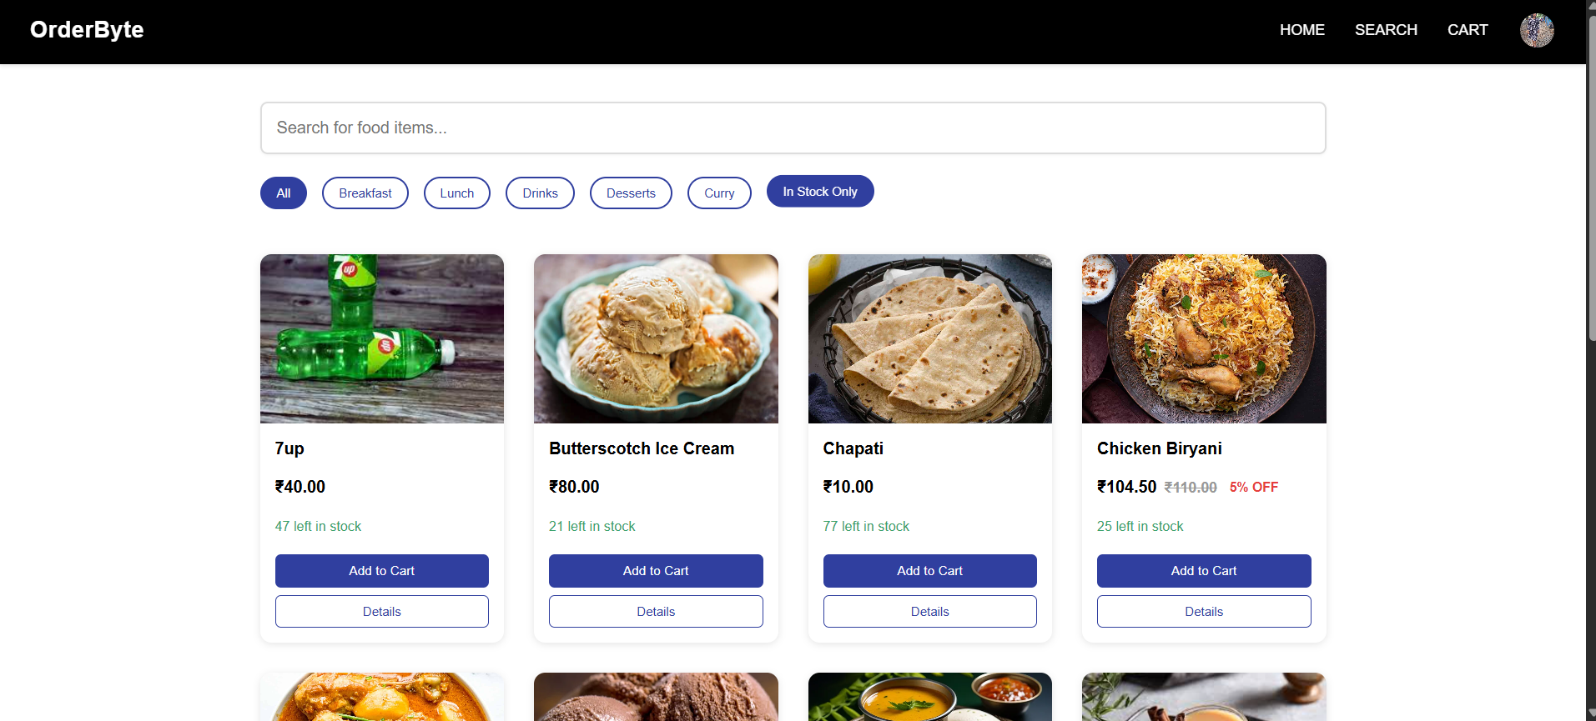
User Search Page
LEARN . GROW . EXCEL

Slide 30
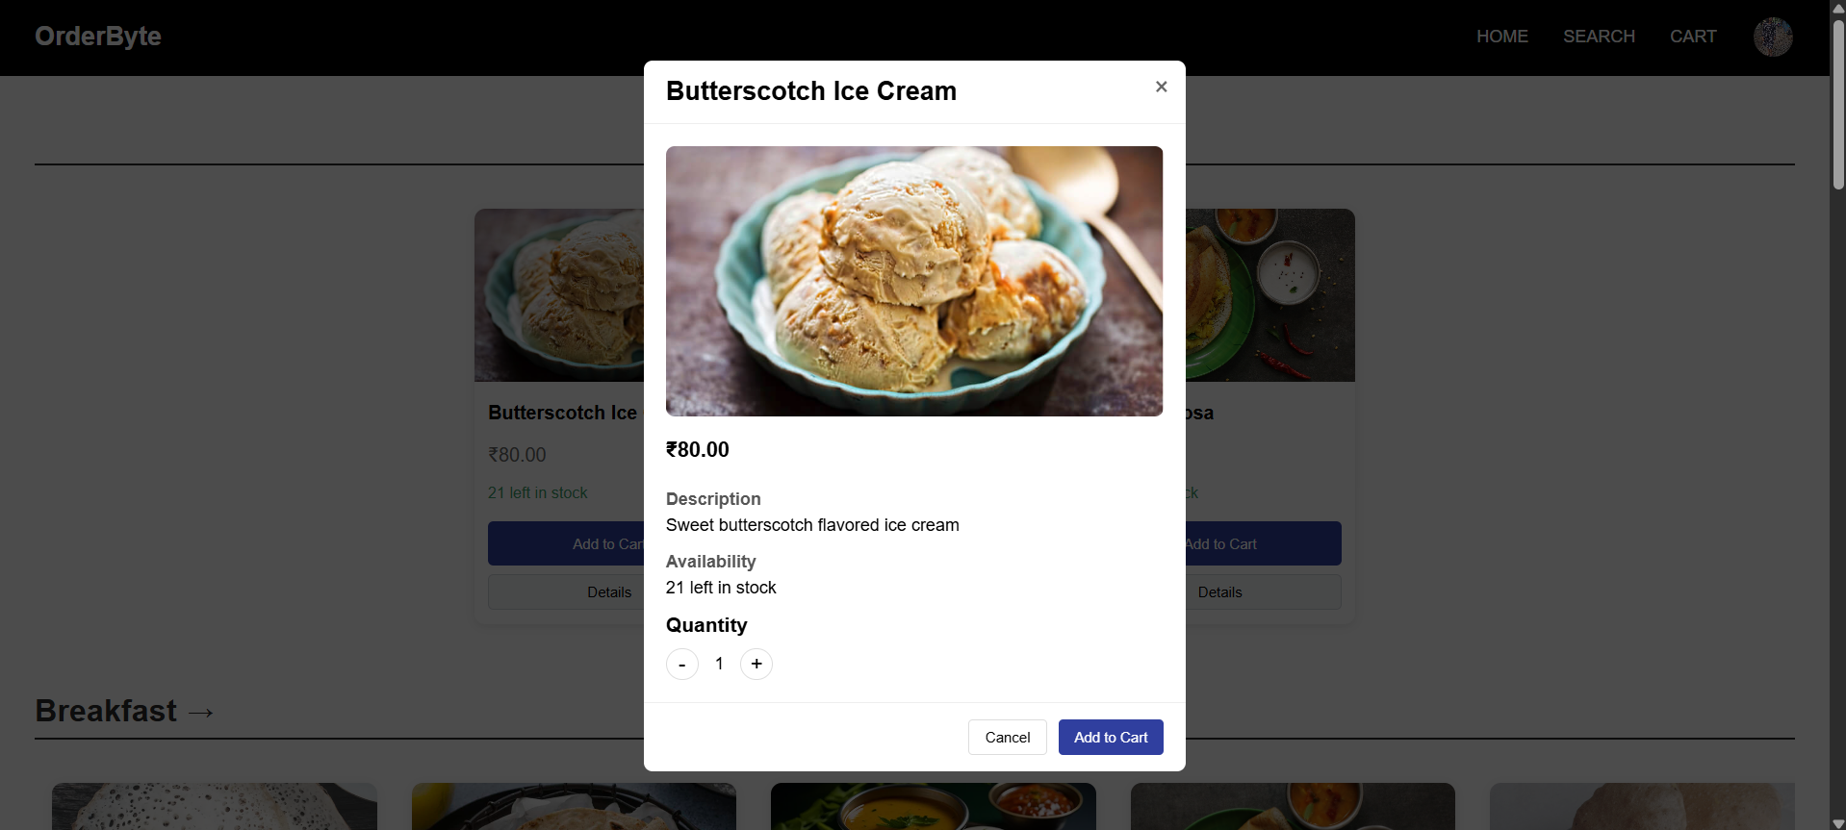
In Stock Item Details
LEARN . GROW . EXCEL

Slide 31
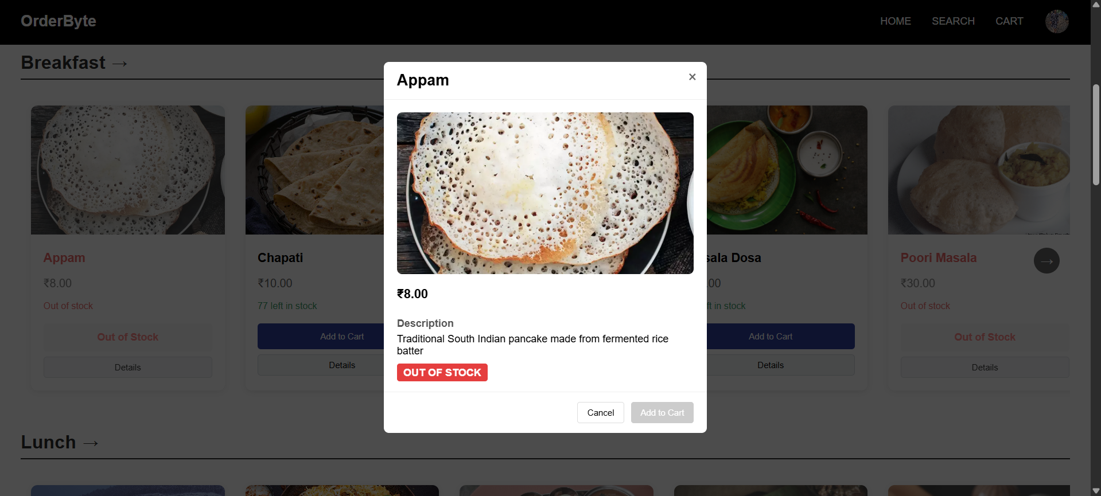
Out of Stock Item Details
LEARN . GROW . EXCEL

Slide 32
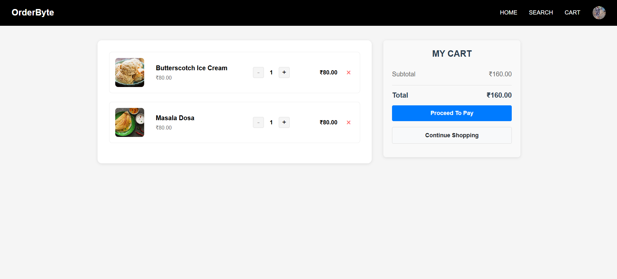
User Cart Page
LEARN . GROW . EXCEL

Slide 33
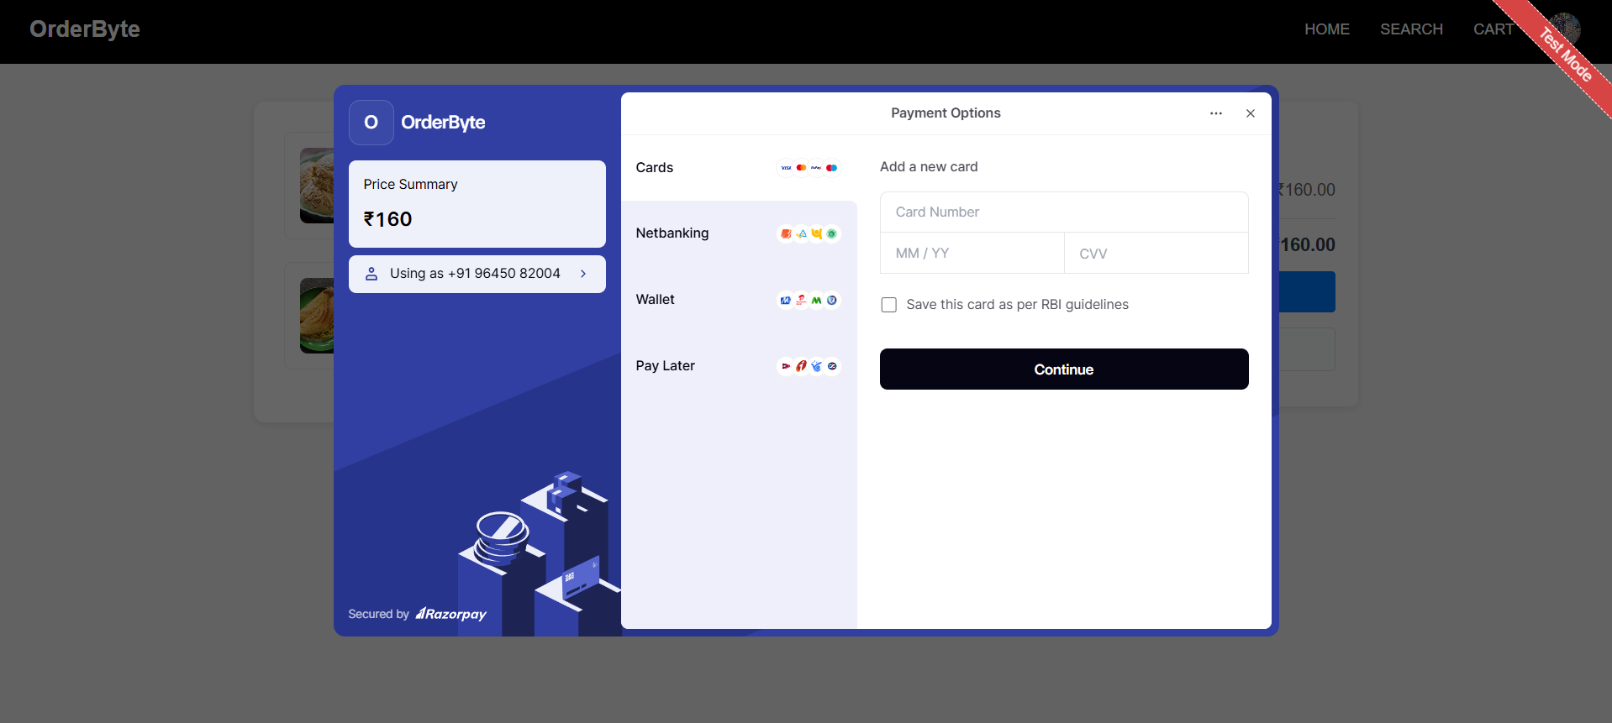
User Checkout Page using RazorPay
LEARN . GROW . EXCEL

Slide 34
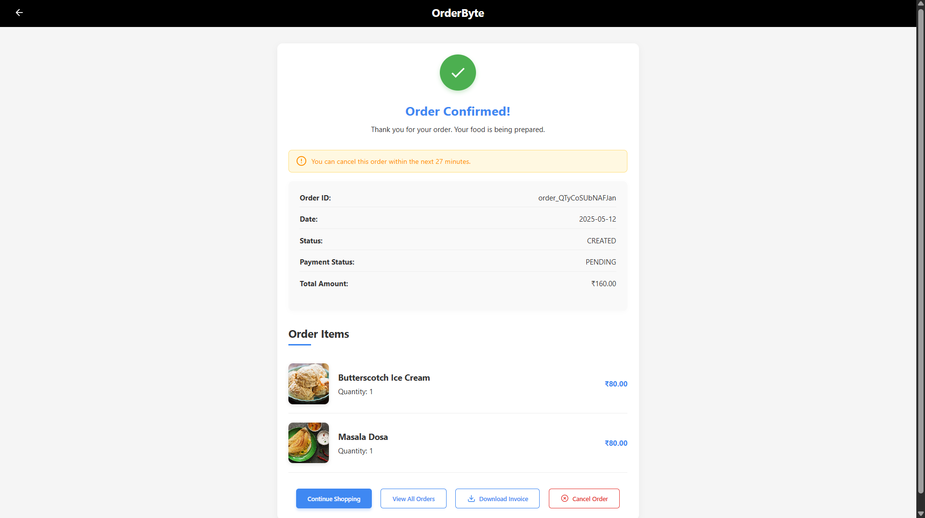
User Order Confirmation Page
LEARN . GROW . EXCEL

Slide 35
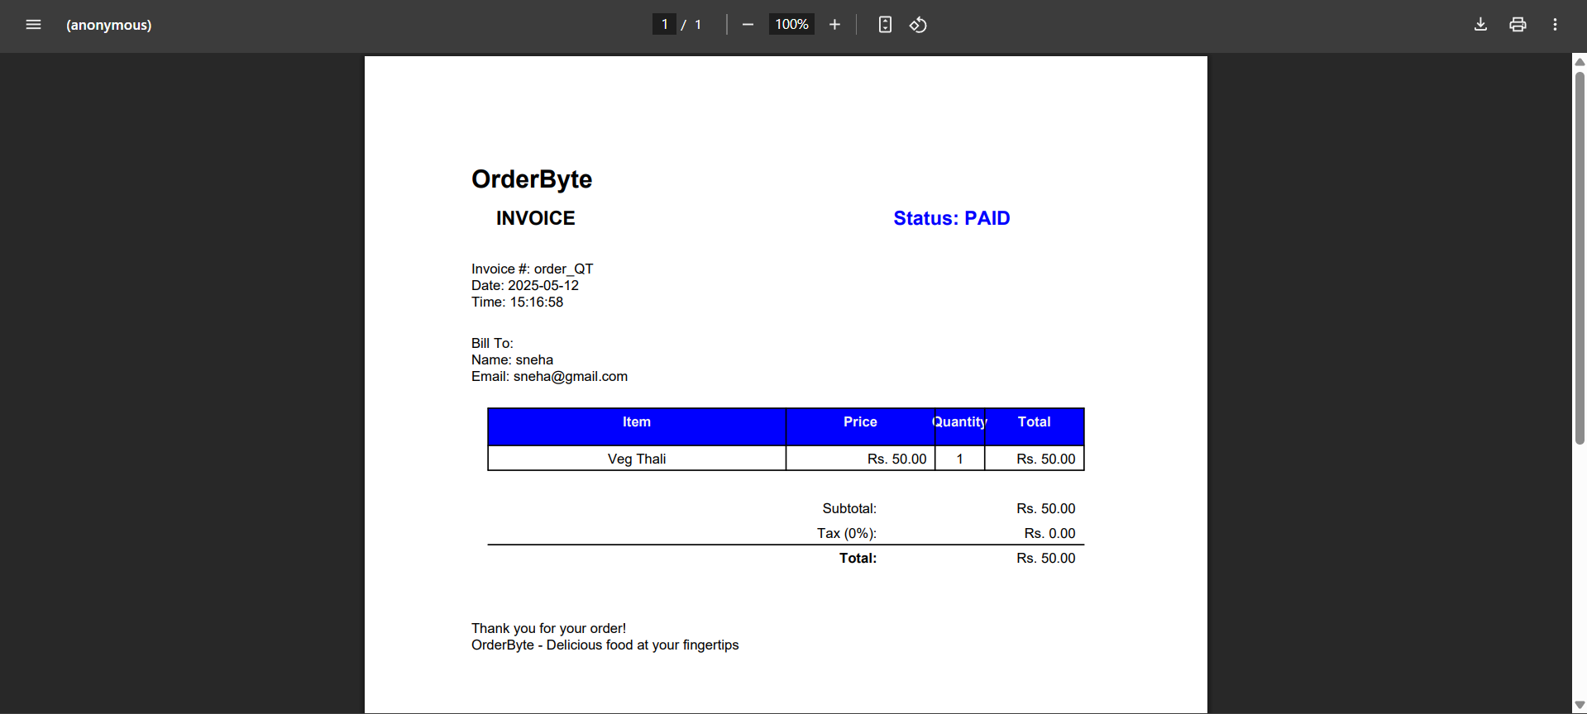
User Invoice for the Order
LEARN . GROW . EXCEL

Slide 36
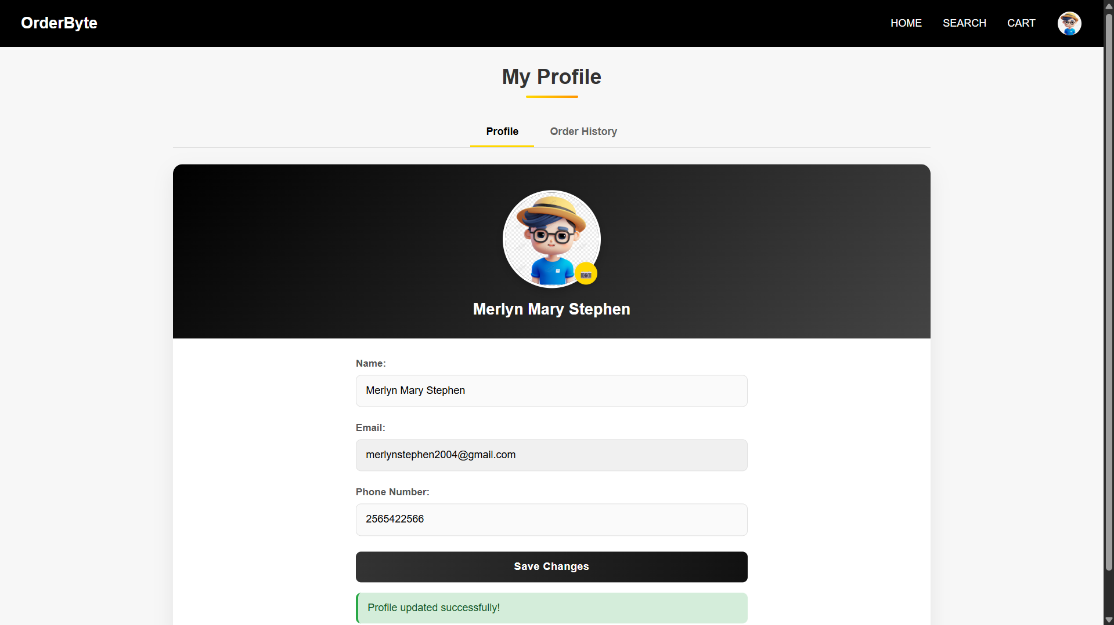
User Profile Page
LEARN . GROW . EXCEL

Slide 37
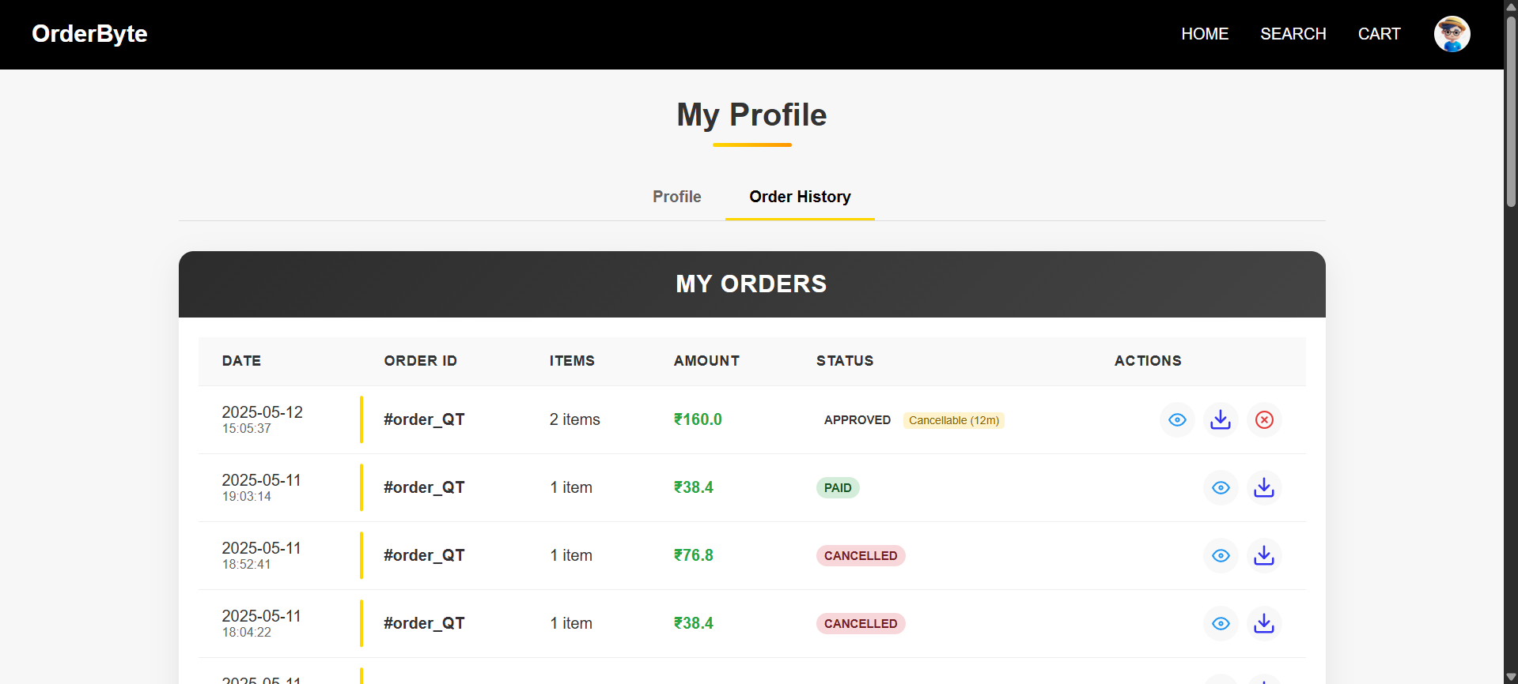
User Order History
LEARN . GROW . EXCEL

Slide 38
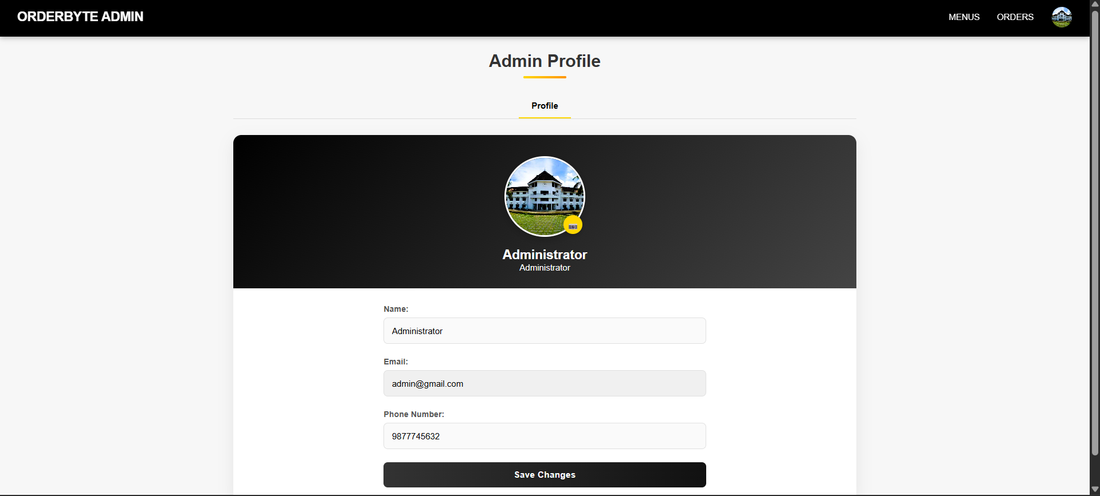
Admin Profile Page
LEARN . GROW . EXCEL

Slide 39
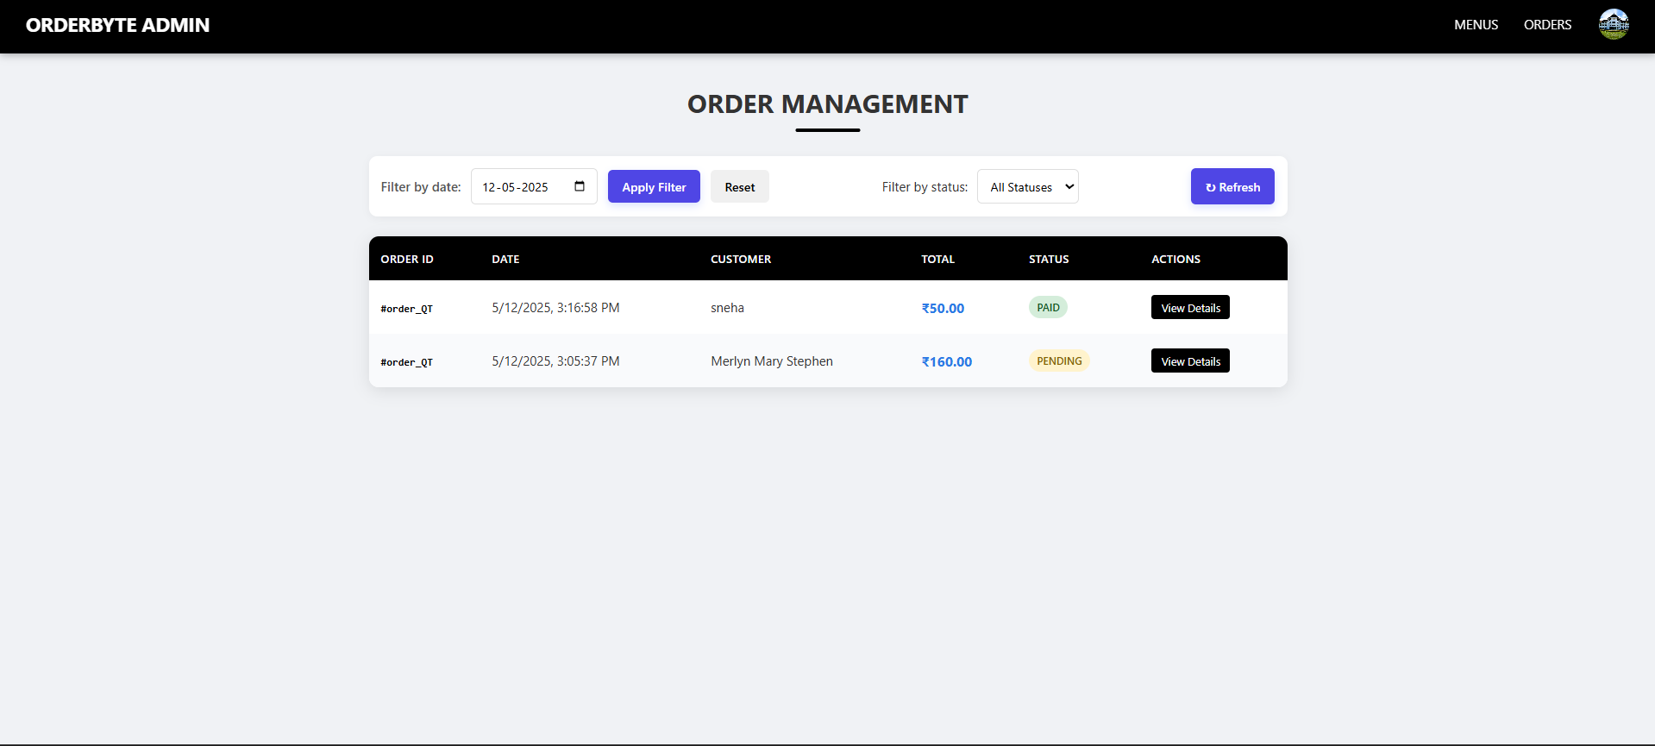
Admin Order Management Page
LEARN . GROW . EXCEL

Slide 40
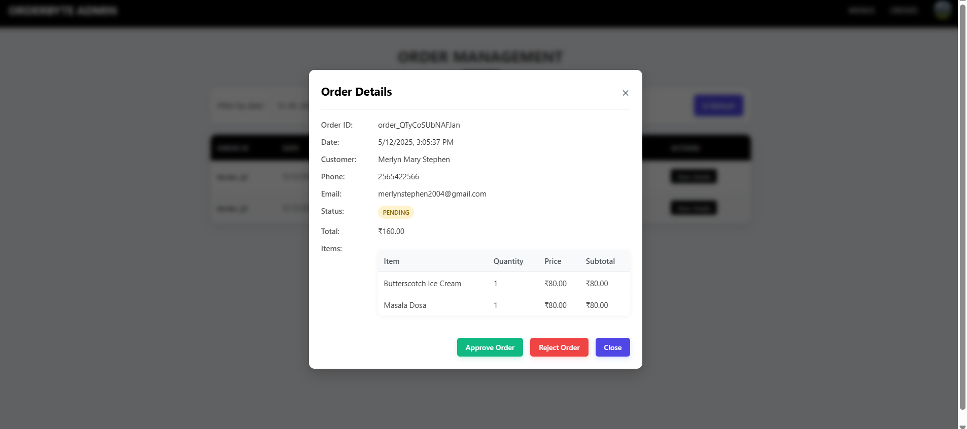
Pending Order Details for Admin
LEARN . GROW . EXCEL

Slide 41
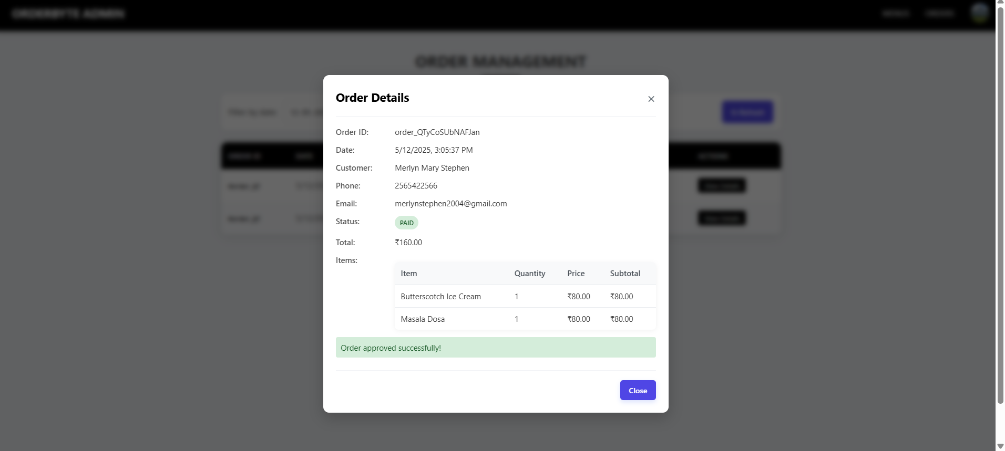
Approval Pending Order by Admin
LEARN . GROW . EXCEL

Slide 42
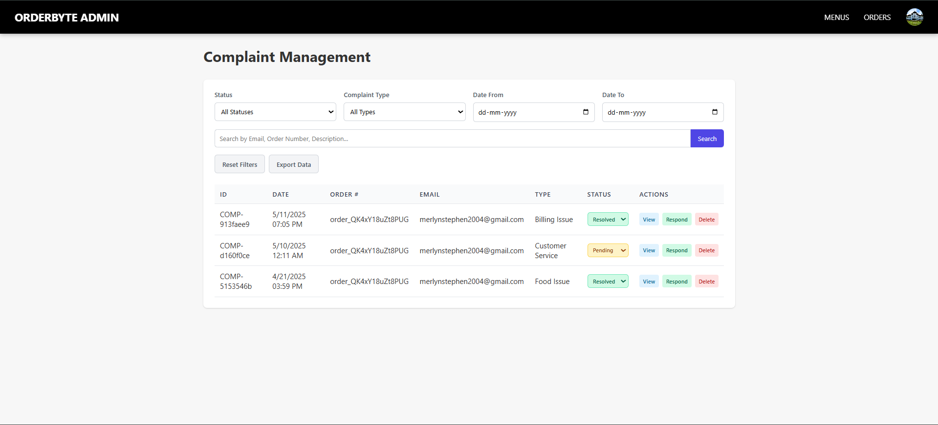
Admin Complaint Management
LEARN . GROW . EXCEL

Slide 43
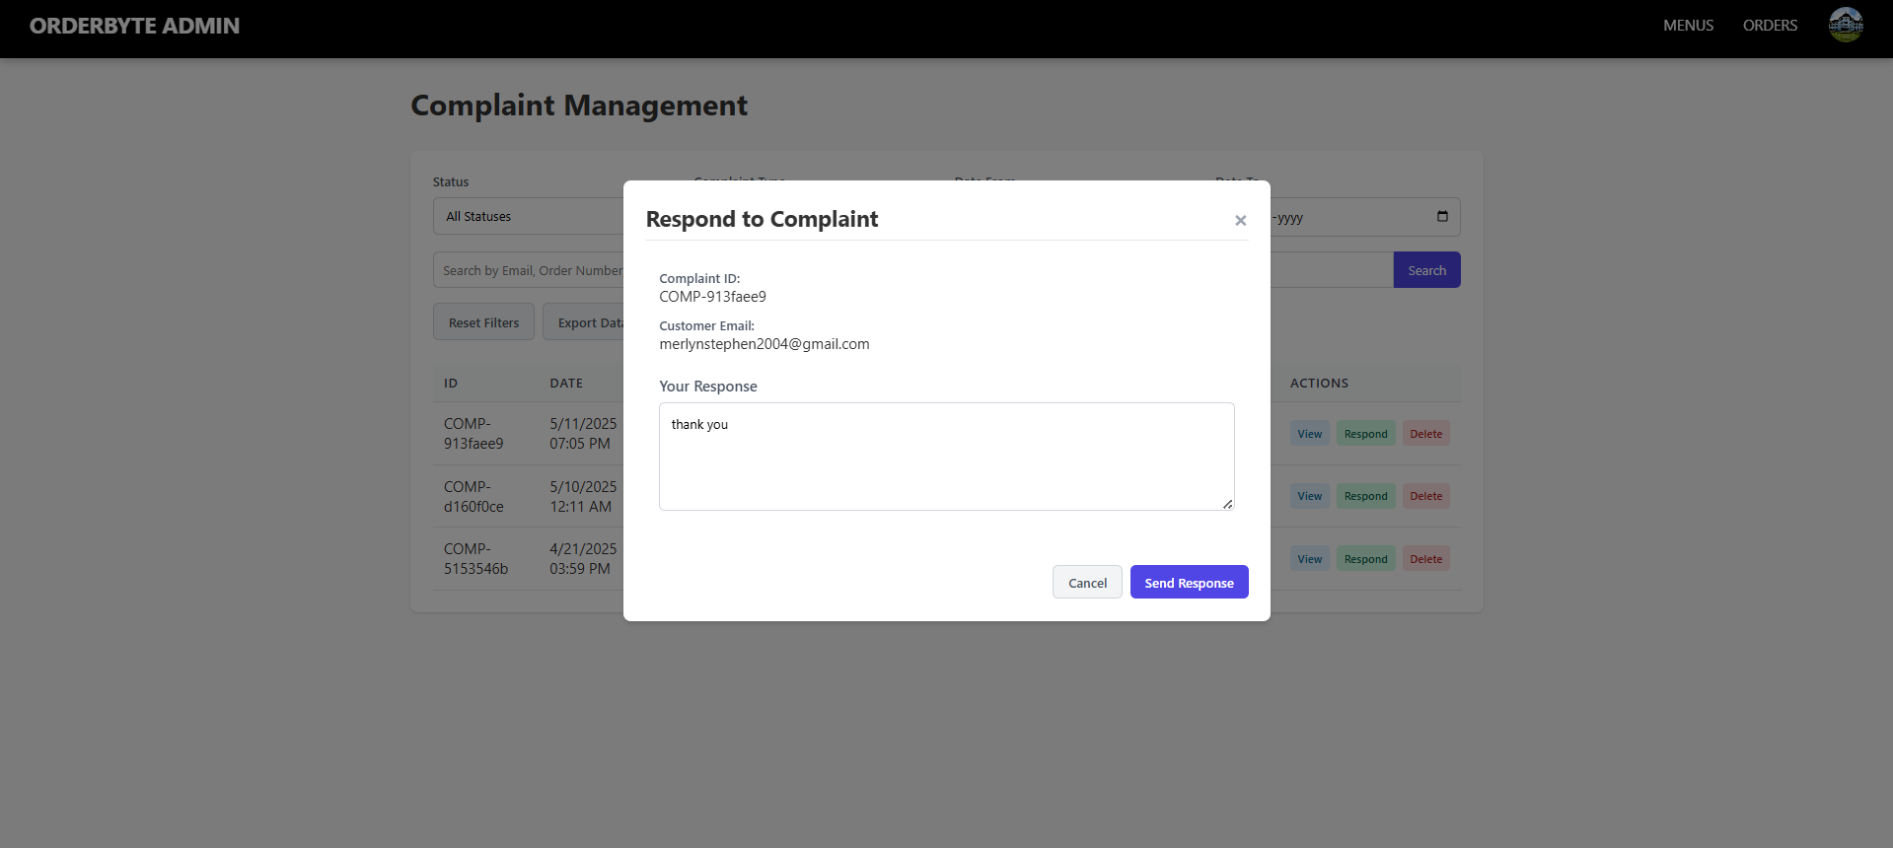
Respond to Complaint by Admin
LEARN . GROW . EXCEL

Slide 44
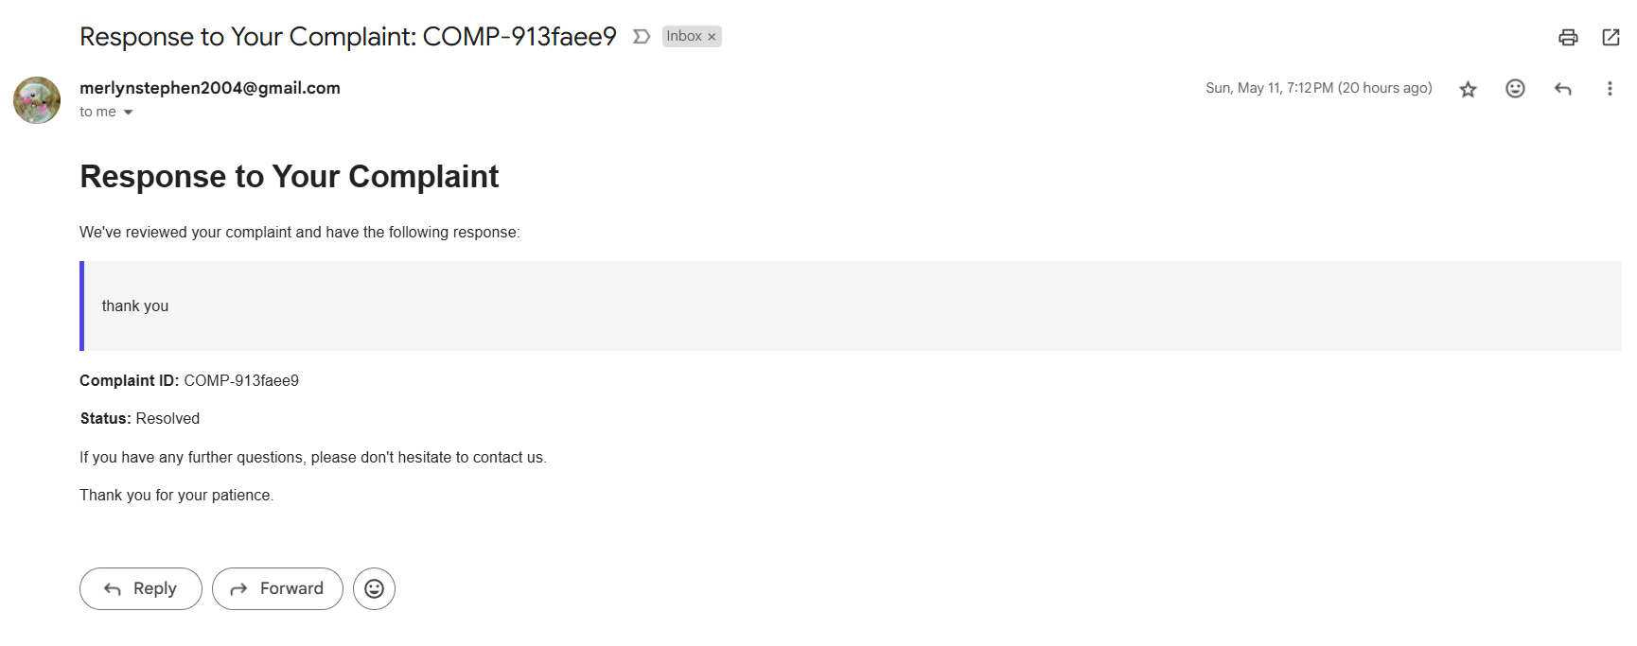
Mail to Admin for Complaint Response
LEARN . GROW . EXCEL

Slide 45
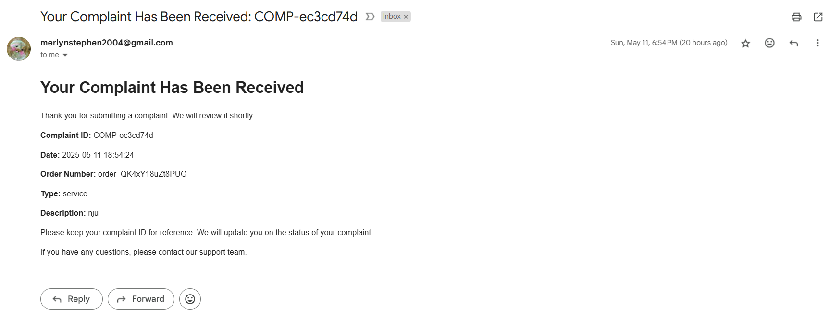
Complaint Filed by User
LEARN . GROW . EXCEL

Slide 46
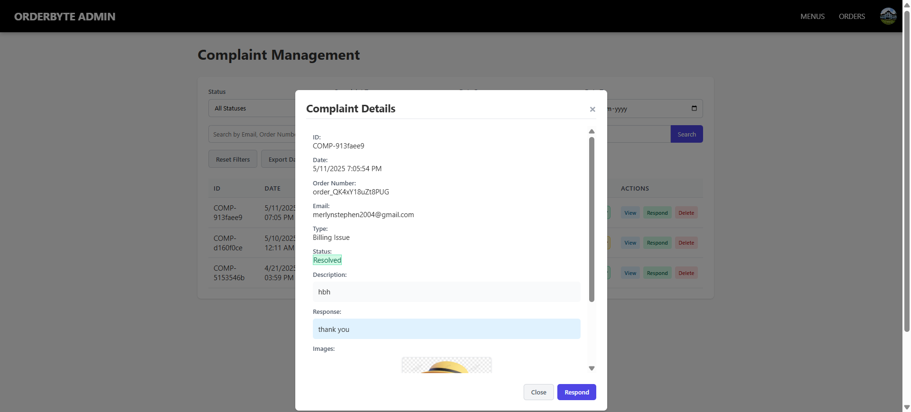
Admin View Complaint
LEARN . GROW . EXCEL

Slide 47
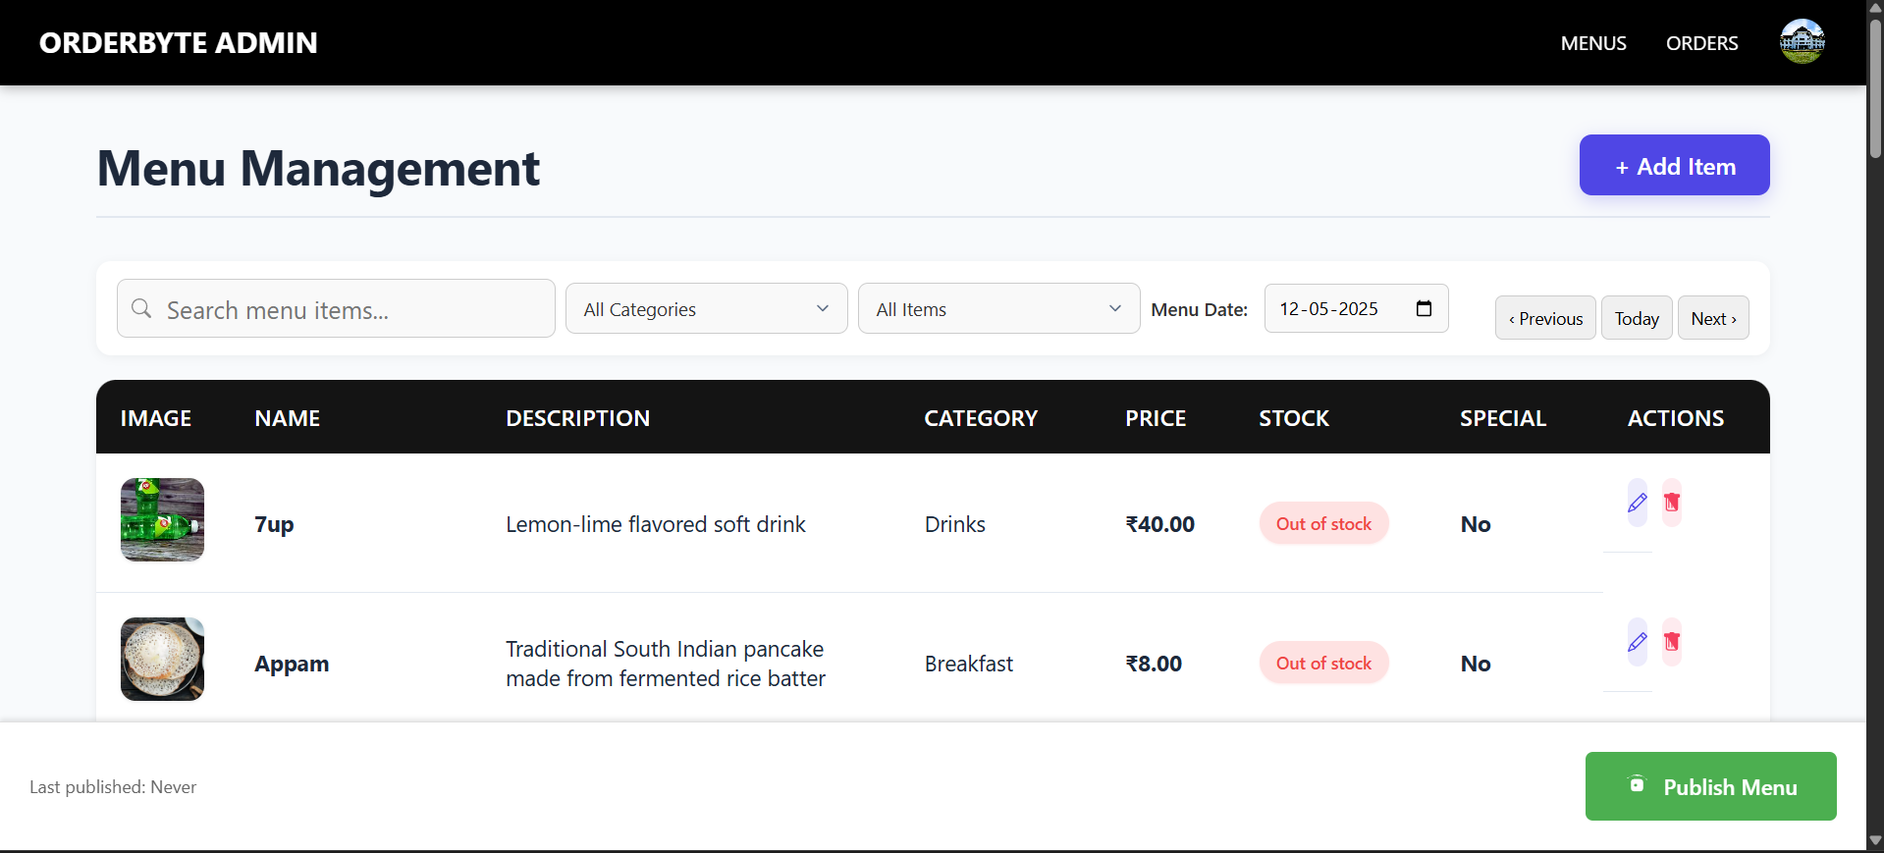
Admin Menu Management
LEARN . GROW . EXCEL

Slide 48
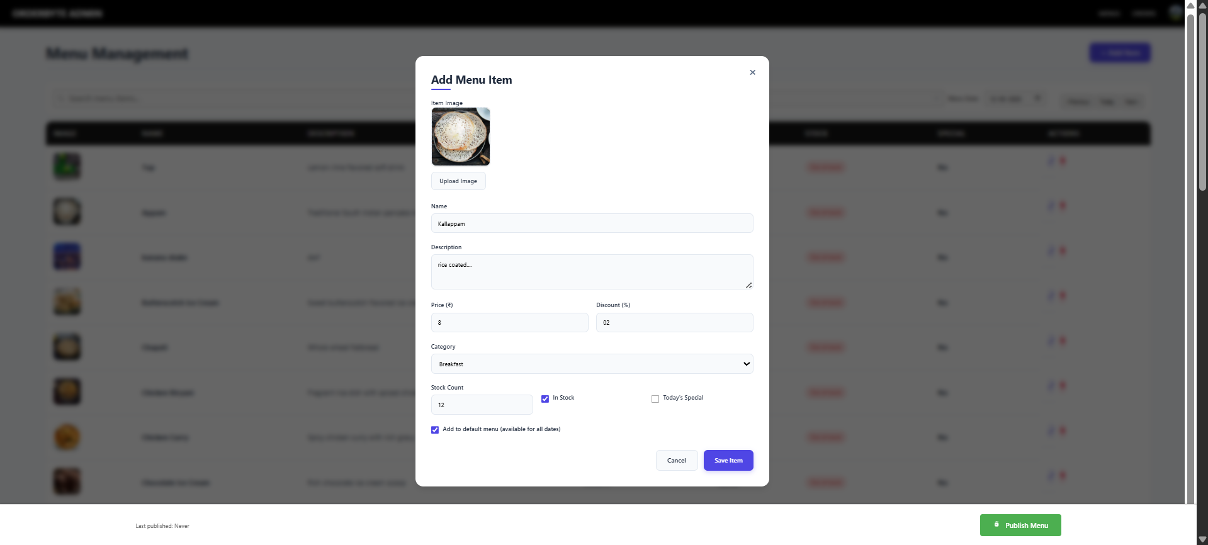
Admin Add Menu Item
LEARN . GROW . EXCEL

Slide 49
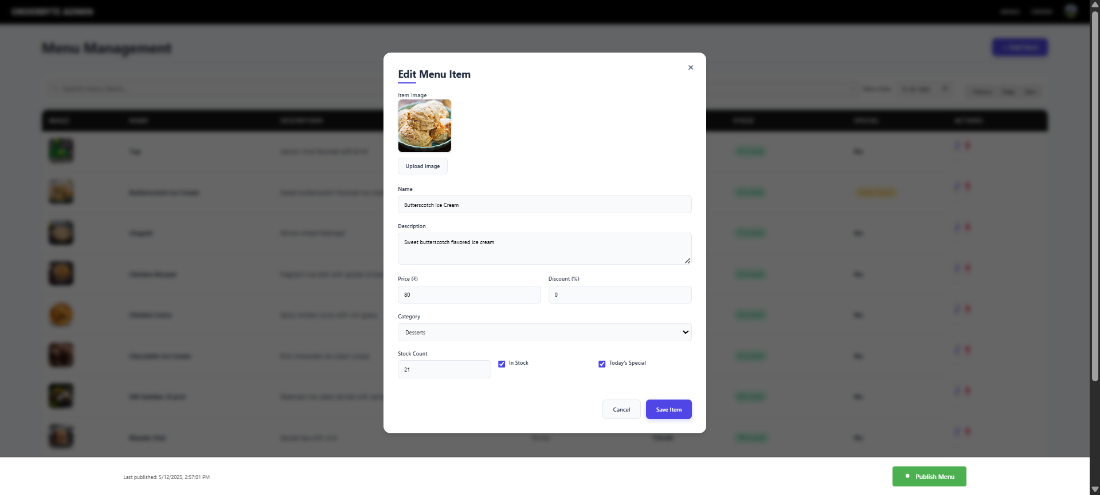
Admin Edit Menu Item
LEARN . GROW . EXCEL

Slide 50
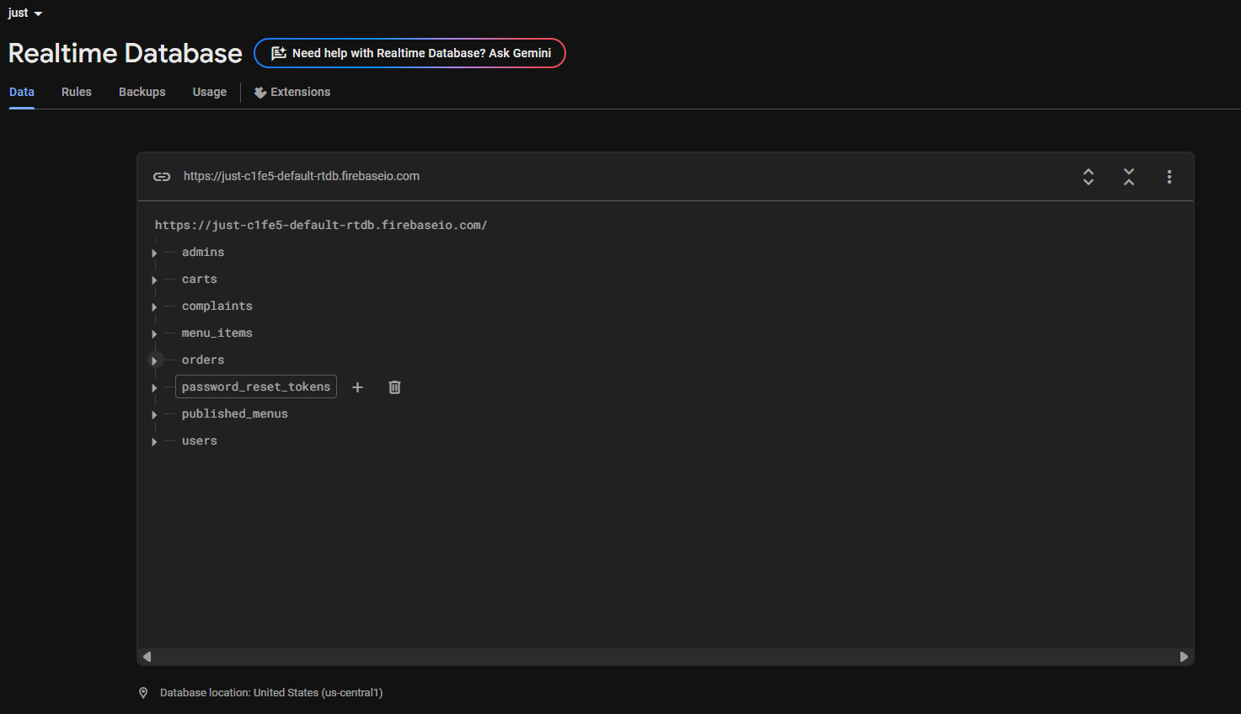
Database
LEARN . GROW . EXCEL

Slide 51
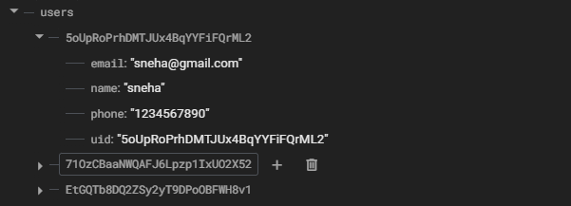
Database User Table
LEARN . GROW . EXCEL

Slide 52
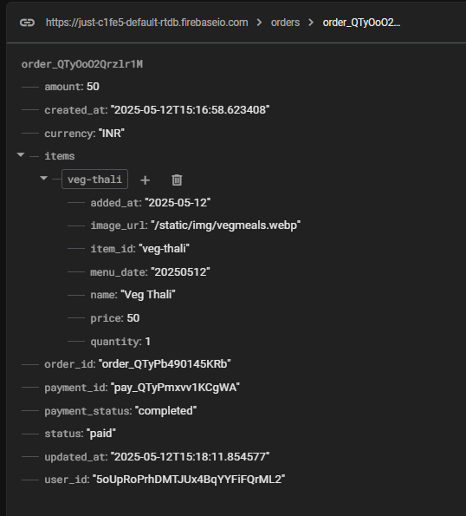
Database Order Table
LEARN . GROW . EXCEL

Slide 53
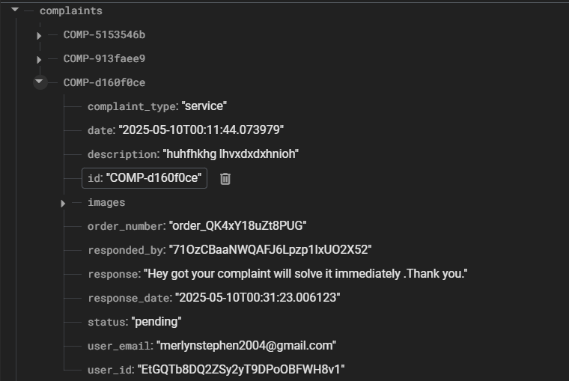
Database Complaint Table
LEARN . GROW . EXCEL

Slide 54
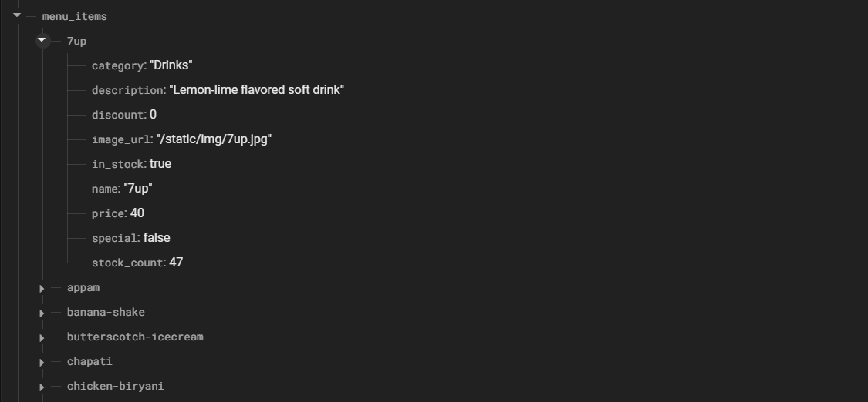
Database Menu Item Table
LEARN . GROW . EXCEL

Slide 55
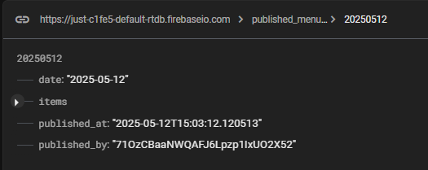
Database Published Menu Items Table
LEARN . GROW . EXCEL

Slide 56
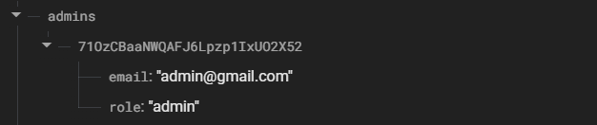
Database Admin Table
LEARN . GROW . EXCEL

Slide 57
Creating Admin User
LEARN . GROW . EXCEL

Slide 58
Creating Admin User
LEARN . GROW . EXCEL

Slide 59
Creating Admin User
LEARN . GROW . EXCEL

Slide 60
Testing
Module | Test Case | Expected Result | Status | Tested by
User Authentication & Profile Management | Valid login with correct credentials | User should be redirected to the dashboard | Pass | Shalin Ann Thomas
User Authentication & Profile Management | Invalid login attempt | Error message should be displayed | Pass | Shalin Ann Thomas
User Authentication & Profile Management | Successful signup with valid details | User should be redirected to login page | Pass | Shalin Ann Thomas
User Authentication & Profile Management | Edit profile with valid inputs | Profile should be updated successfully | Pass | Shalin Ann Thomas
Menu Management | Admin adds a new menu item | Menu item should be displayed on the user side | Pass | Sneha Mariam Samuel
Menu Management | Admin edits an existing item | Updated details should reflect instantly | Pass | Sneha Mariam Samuel
Menu Management | Admin deletes a menu item | Item should be removed from user view | Pass | Sneha Mariam Samuel
Order Management | View daily menu | Only current day's menu should be visible | Pass | Sneha Mariam Samuel
Cart operations | Add items to cart | Items should be displayed in the cart with correct details | Pass | Rinny Anna Thomas
Cart operations | Modify cart items | Updated quantity and price should reflect accurately | Pass | Rinny Anna Thomas
Cart operations | Remove items from cart | Item should be removed and total price updated | Pass | Rinny Anna Thomas
Cart operations | Total price calculation | Price should be accurately calculated | Pass | Rinny Anna Thomas
Cart operations | Update item quantity | Database reflects the correct quantity | Pass | Rinny Anna Thomas
Payment System | Payment with demo card | Demo payment should process without errors | Pass | Merlyn Mary Stephen
Payment System | Payment confirmation | Payment confirmation message should be shown | Pass | Merlyn Mary Stephen
Payment System | Cart clearance after payment | Cart should be cleared after payment | Pass | Merlyn Mary Stephen
User Interface & Navigation | Button redirection | All buttons should link to the correct pages | Pass | Merlyn Mary Stephen
User Interface & Navigation | Back button functionality | Back button should not log out the user | Pass | Merlyn Mary Stephen
User Interface & Navigation | Error message display | Error messages should be clear and readable | Pass | Sneha Mariam Samuel
Authentication | User login with valid credentials | User is authenticated and redirected to the dashboard | Pass | Shalin Ann Thomas
Authentication | User login with invalid credentials | Error message is displayed | Pass | Shalin Ann Thomas
Authentication | Password reset with valid email | Reset link is sent to the corresponding email | Pass | Merlyn Mary Stephen
Authentication | Password reset with invalid email | Error message is displayed | Pass | Merlyn Mary Stephen
Database Operations | Add new menu item | Menu item is successfully stored in the database | Pass | Rinny Anna Thomas
Database Operations | Delete menu item | Menu item is removed from the database | Pass | Rinny Anna Thomas
Database Operations | Retrieve today's menu | Today's menu is displayed correctly | Pass | Sneha Mariam Samuel
Error Handling | Invalid menu item access | System shows 'Item not found ' error | Pass | Merlyn Mary Stephen
Error Handling | Database connection error | System displays appropriate error message | Pass | Merlyn Mary Stephen
LEARN . GROW . EXCEL

Slide 61
Future Scope
AI-Powered Meal Recommendations – Use machine learning to analyze order history and suggest personalized meals.
Smart Inventory & Waste Management – Implement AI-driven demand prediction and real-time expiry tracking to reduce food waste.
Advanced Payment Integration – Support UPI, NFC, and subscription-based meal plans for seamless transactions.
Mobile App Development – Build a dedicated Android & iOS app with push notifications for order updates.
Multi-Campus Expansion – Enable centralized management and inter-college meal pre-booking across institutions.
LEARN . GROW . EXCEL

